Slide 1
Files lab 8
Dr : Ghada
Eng : Gehad Mustafa
Eng : Somaya Yasser

Slide 2
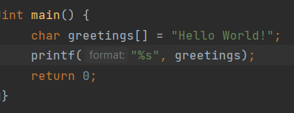
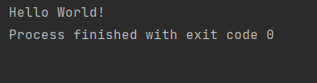
Strings
C does not have a String type to easily create string variables.
Instead, you must use the char type and create an array of characters to make a string in C

Slide 3
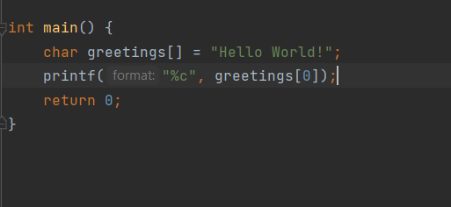
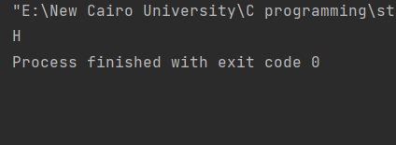
Access Strings
you can access a string by referring to its index number inside square brackets []

Slide 4
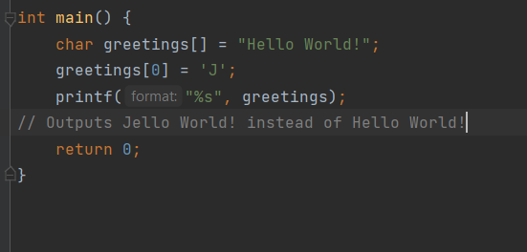
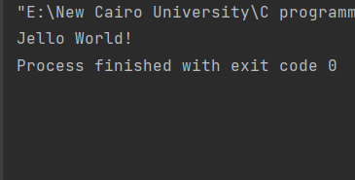
Modify String

Slide 5
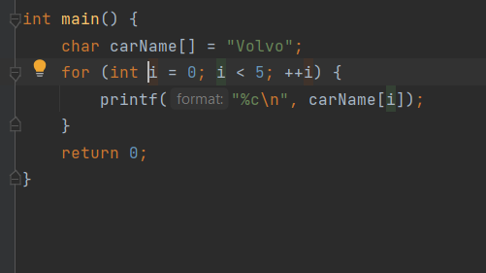
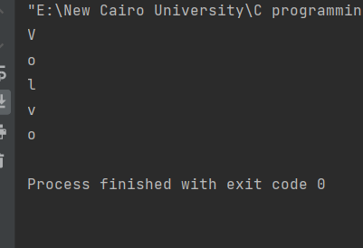
Loop through string

Slide 6
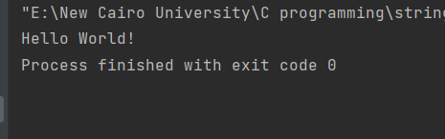
Another way to create string

Slide 7
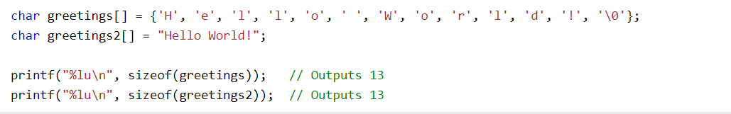
Difference

Slide 8

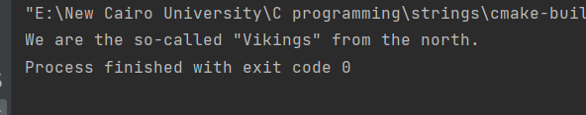
Special Characters

Slide 9

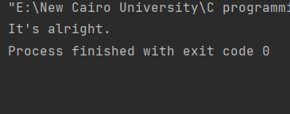

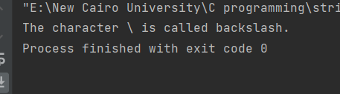
Special Chars (cont.)

Slide 10
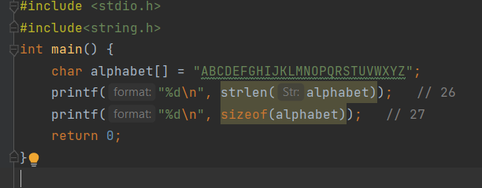
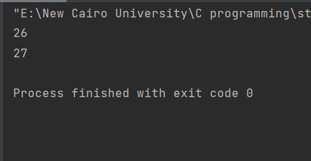
String Functions
To use them, you must include the <string.h> header file in your program.

Slide 11
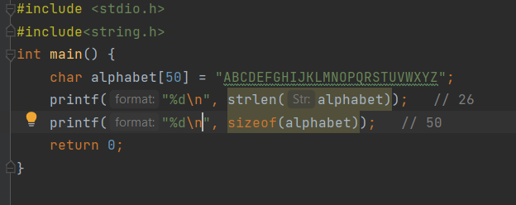
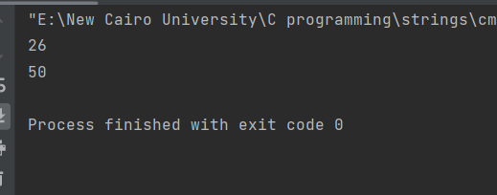
String length

Slide 12
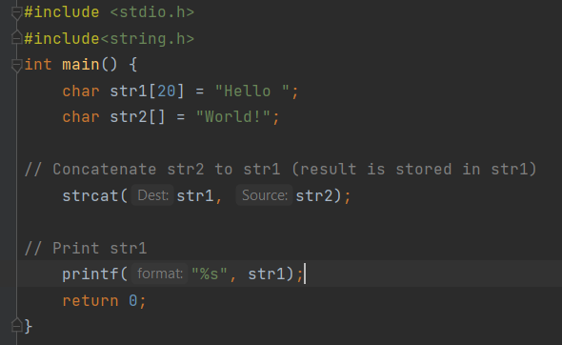
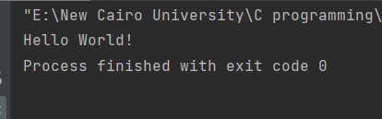
Concatenate

Slide 13
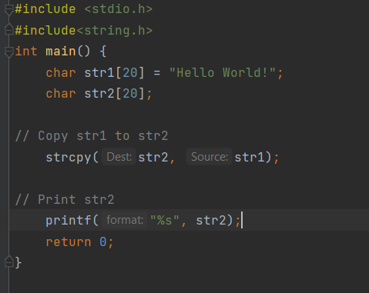
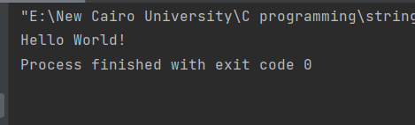
Copy string

Slide 14
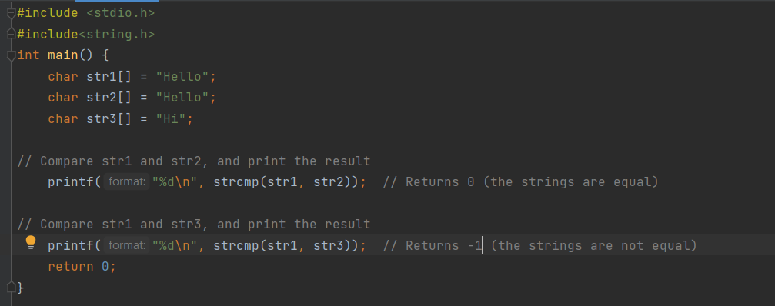
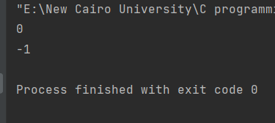
Compare strings

Slide 15
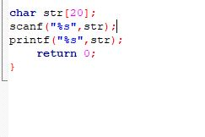
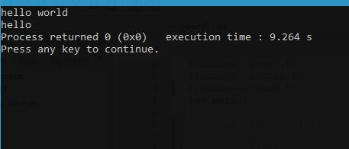
Input string

Slide 16
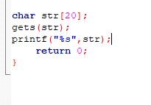
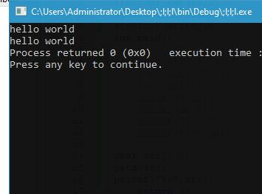
Input string with space

Slide 17
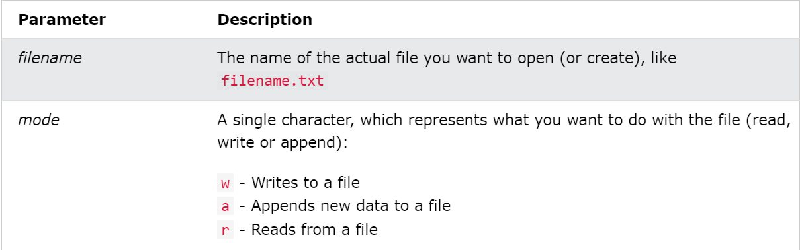
File Handling
In C, you can create, open, read, and write to files by declaring a pointer of type FILE, and use the fopen() function.
FILE *fptr; fptr = fopen(filename, mode);

Slide 18
Create a File
To create a file, you can use the w mode inside the fopen() function.
The w mode is used to write to a file.
If the file does not exist, it will create one for you.

Slide 19
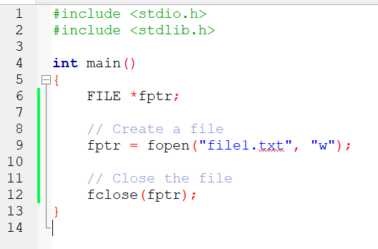
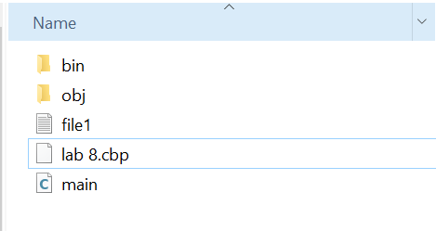
Create a File

Slide 20
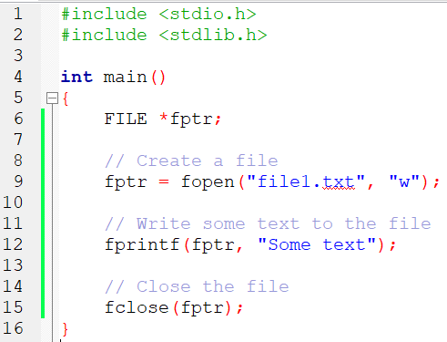
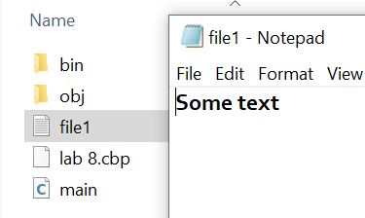
Write To a File

Slide 21
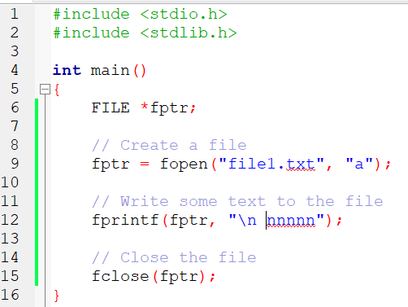
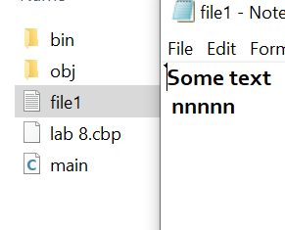
Append Content To a File

Slide 22
Read a File
To read from a file, you can use the r mode.
In order to read the content of file, we can use the fgets() function.

Slide 23
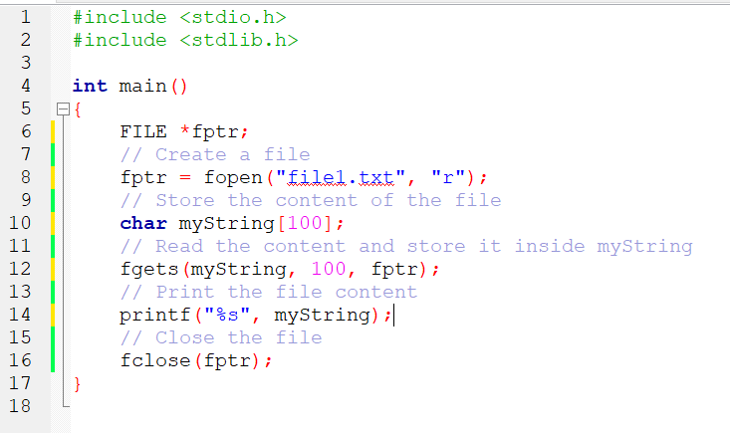
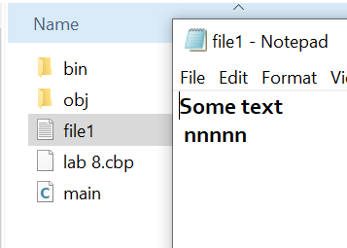
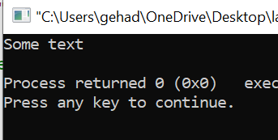
Read a File

Slide 24
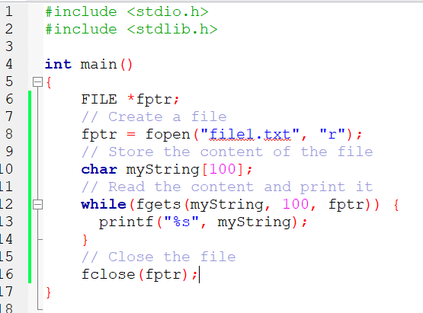
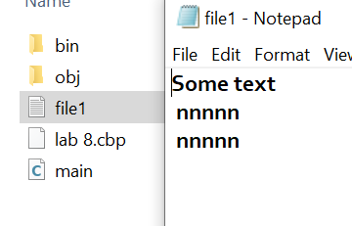
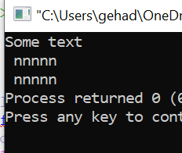
Read a File

Slide 25
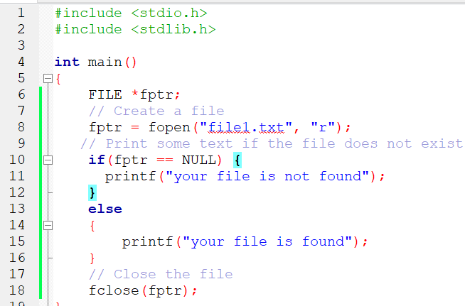
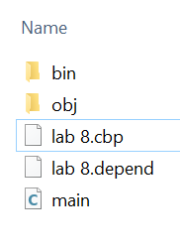
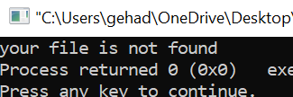
File exist
If you try to open a file for reading that does not exist, the fopen() function will return NULL.
As a good practice, we can use an if statement to test for NULL, and print some text instead

Slide 26
Try
Try to create a file named(my_file.txt) and write
your name
your age
Your address
Your id
Try to write c code to check If the file exist, If the file does not exist, print a message : Not found
If it is exist read the content and print it.

